Slide 1
Changes to the AJCC Staging of Head & Neck Cancer:
Implications for the Surgical Pathologist
Presented by: William Westra M.D.
Disclosures: Special advisor to Merck, AstraZeneca, Champions Oncology, and the National Cancer Institute
Notes:
As you move to the next phase of your career I want you to keep a few things in mind

Slide 2
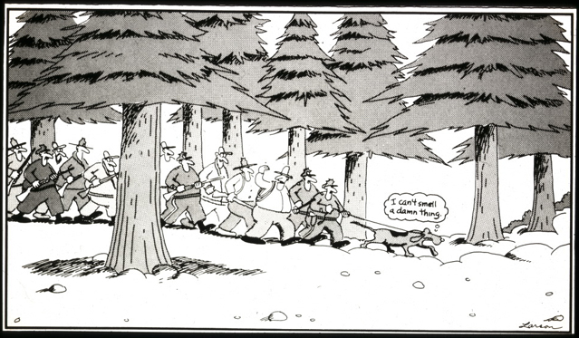

Slide 3
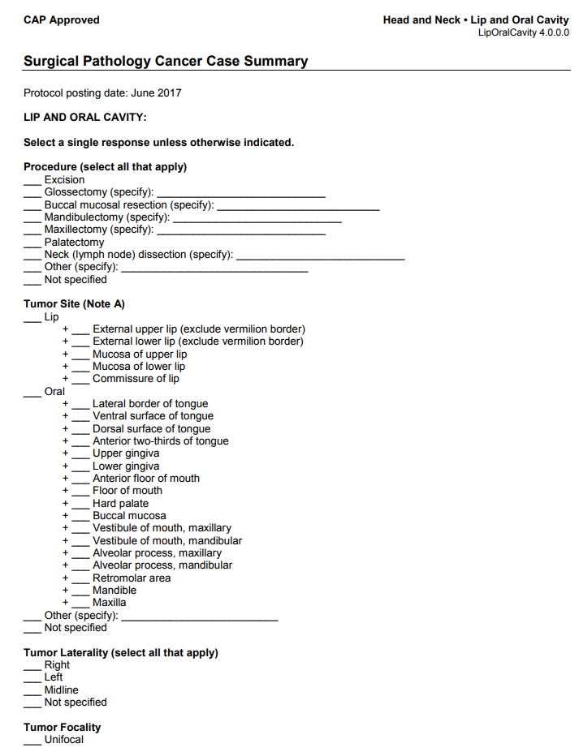
AJCC staging
Standardized International Nomenclature
Standardized Staging
Direct therapy
Measure end results
Estimate prognosis
W.H.O.
Blue Book
C.A.P.
Standardized Reporting
(surgical pathology report)

Slide 4
AJCC Changes for 8th Edition
New chapters/staging systems
Cervical Lymph Nodes and Unknown 1̊ Tumors of the Head & Neck
Pharynx: HPV-Mediated Oropharynx Cancer (p16+)
Cutaneous Squamous Cell Carcinoma of the Head and Neck
Thymus
Bone: Appendicular Skeleton/Trunk/Skull/Face, Pelvis, and Spine
Soft Tissue Sarcoma of the Head and Neck
Soft Tissue Sarcoma of the Trunk and Extremities
Soft Tissue Sarcoma of the Abdomen and Thoracic Visceral Organs
Soft Tissue Sarcoma of the Retroperitoneum
Soft Tissue Sarcoma – Unusual Histologies and Sites
Parathyroid
Leukemia
Split chapters
P16 negative oropharynx and hypopharynx (previously pharynx)
Nasopharynx (previously pharynx)

Slide 6
Change 1.
Repositioning of Anatomic Boundaries of the Head and Neck from an Oncologic HPV Perspective

Slide 7
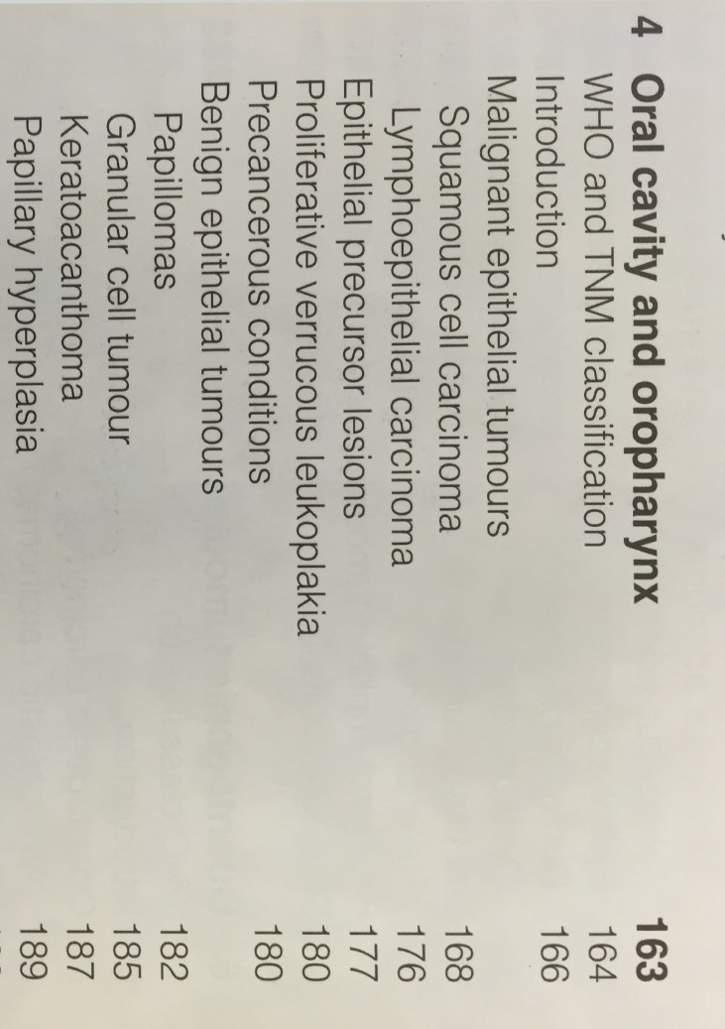
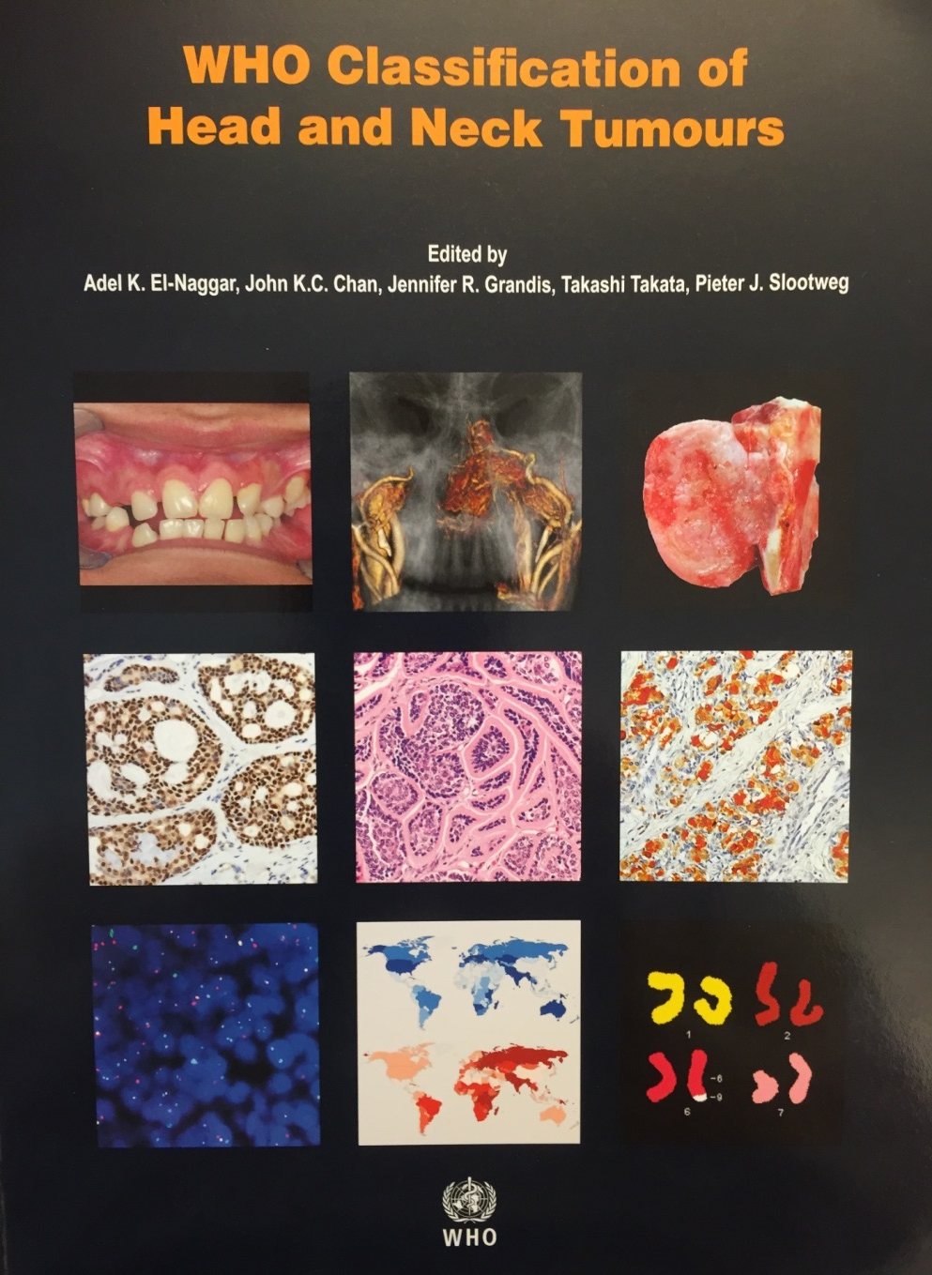
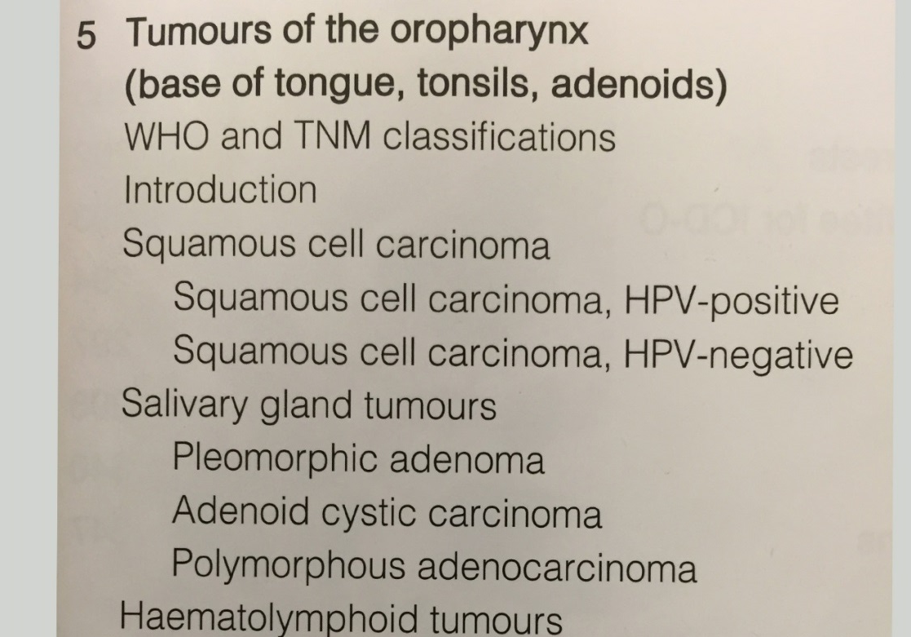
2005 edition
2017 edition

Slide 8
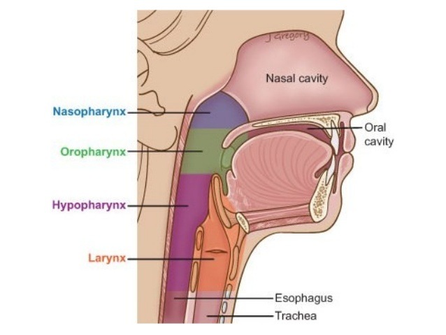
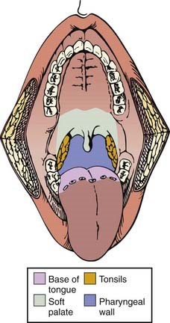
“To reflect the very different biological and etiological differences between nasopharyngeal carcinoma,
HPV-associated OPC, non-HPV-associated OPC, and hypopharyngeal cancer, the 8th edition of the
staging manual has been divided into 3 separate chapters – nasopharynx, HPV-associated OPC, and
Hypopharyngeal / non-HPV associated OPC.”
Lydiatt et al. CA A Cancer J Clin, 67:122, 2017

Slide 9
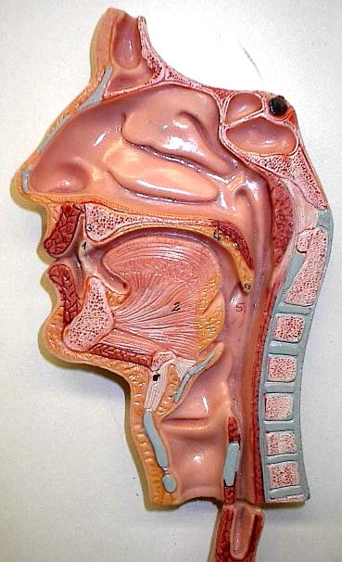
Anatomic distribution of HPV-related HNSCC
Nasopharynx
(? %)
Oropharynx (80%)
Sinonasal (30%)
Hypopharynx (~ 5%)
Oral cavity (~ 5%)
Larynx (~ 5%)
Singhi, Westra. Cancer 116:2166-73, 2010

Slide 10
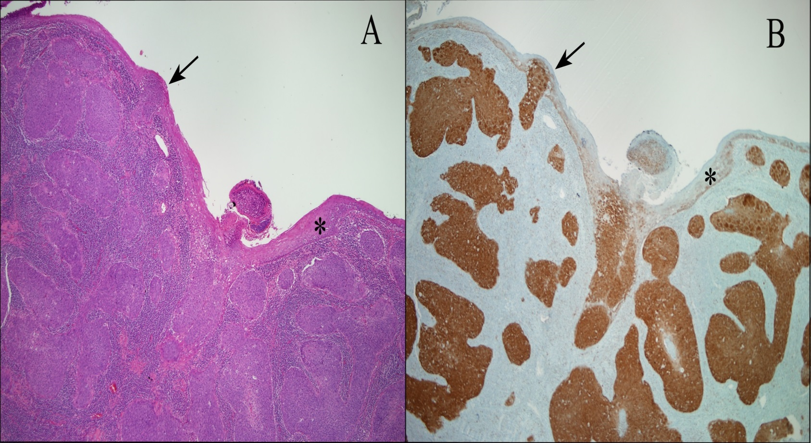
HPV positive zone
HPV negative zone

Slide 11
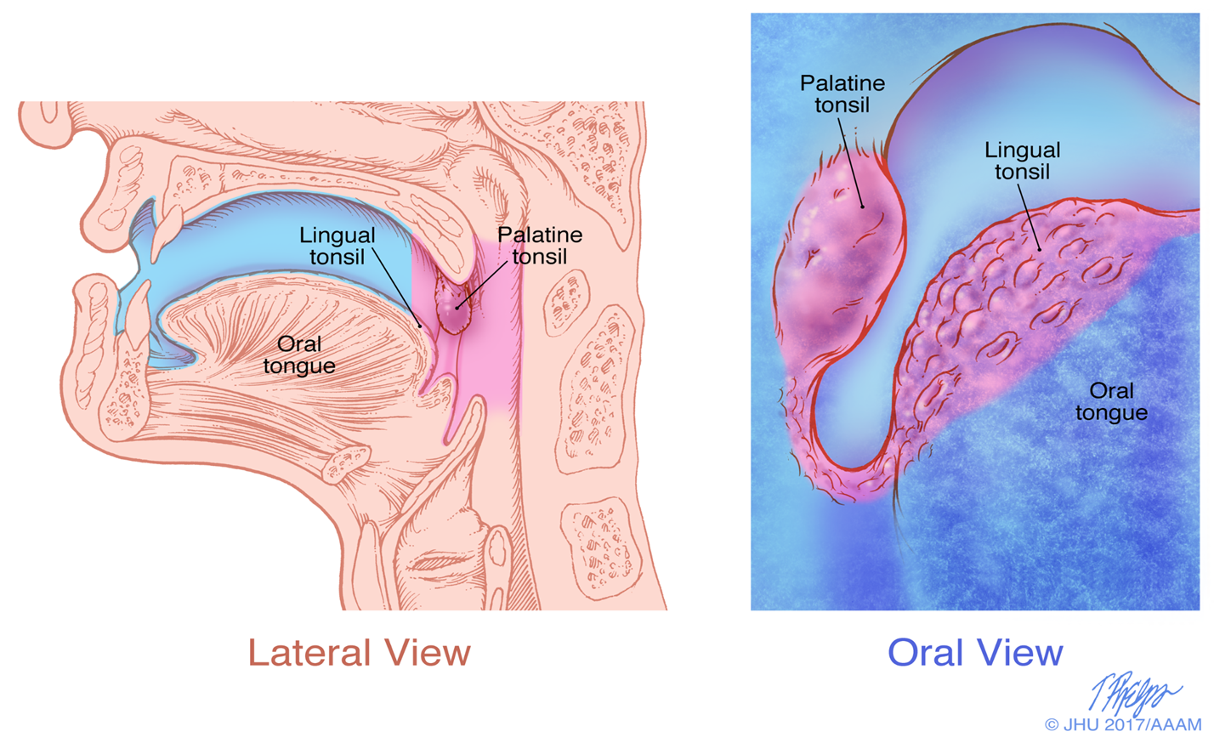
HPV detection in oropharyngeal squamous cell carcinomas
Of non-tonsillar sites
Location | P16 -/HPV - | p16 +/HPV - | P16 +/HPV +
Soft palate (n=30) | 29 | 1 | 1
Posterior pharyngeal wall (n=1) | 1 | 0 | 0
Gelwan, Westra (Am J Surg Pathol 2017 41:1722) |  |  | 1 of 32 (3%)
oncogenic HPV specifically targets the specialized reticulated epithelium of the tonsillar crypts and not the squamous epithelium lining the surface of the oropharynx
consideration of further anatomic subtyping of the oropharynx and oral cavity based on the presence or absence of tonsillar tissue
challenges the routine and indiscriminant testing of all oropharyngeal SqCCs for the presence of HPV irrespective of anatomic subsite
reported rates of HPV in oropharyngeal SqCC may vary depending on the anatomic distribution of the tumors within the oropharynx.

Slide 12
Change 2.
Molecular staging of oropharyngeal
squamous cell carcinomas

Slide 13
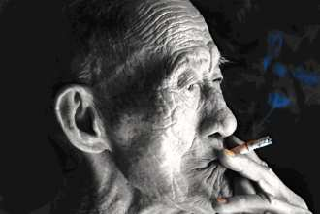
“I was in my 40s,
with a young son,
and my wife and I
were building a life
around him. That’s
when something
from my past
threatened to
take it all away”
Stephen Reynolds
Readers Digest
Aug 2008

Slide 14
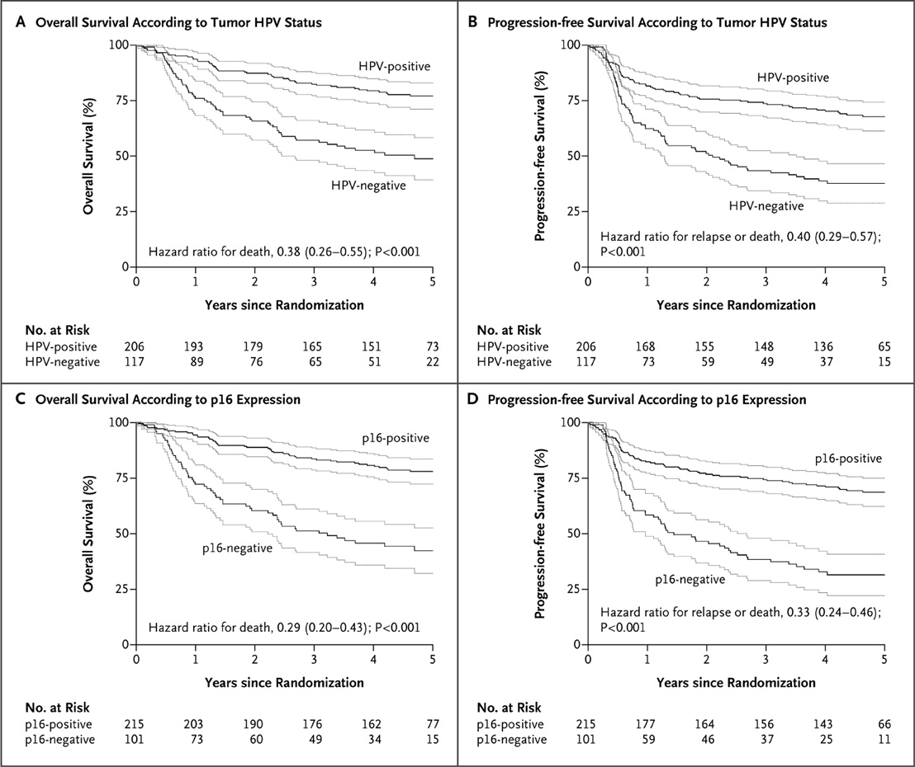
Two distinct HNSCCs
HPV + HPV -
Age younger older
Gender 3:1 men 3:1 men
SE status high low
Molecular
p16 ↑ inactivated
Rb ↓ ↑
P53 wt mutated
Survival better worse
Ang et al. NEJM 363:24-35, 2010

Slide 15
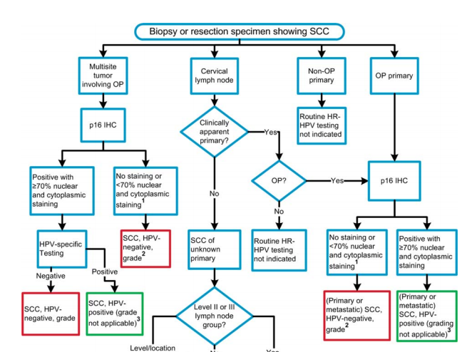
College of American Pathologist:
Guidelines for HPV Testing of Head and Neck Cancer (Arch Pathol. 2018 May;142:559-597

Slide 16
Human Papillomavirus Testing in Head and Neck Carcinomas
Guidelines from the College of American Pathologists (Arch Pathol. 2017, Epub ahead of press)
Guideline 1:
Pathologists should perform high risk human papillomavirus (HR-HPV) testing on all patients with newly diagnosed oropharyngeal squamous cell carcinoma (OPSCC)…
Guideline 2:
For oropharyngeal tissue specimens (i.e., non-cytology), pathologists should perform HR-HPV testing by surrogate marker p16 IHC. Additional HPV-specific testing may be done at the discretion of the pathologist and/or treating clinician, or in the context of a clinical trial.
Guideline 4:
Pathologists should not routinely perform HR-HPV testing on patients with non-oropharyngeal primary tumors of the head and neck

Slide 17
Why not routinely test non-oropharyngeal sites?
HPV positive tumors map to the oropharynx
It remains to be proved that the presence of HPV in non-oropharyngeal HNSCCs is prognostically or clinically relevant
Low positive predictive value for p16 IHC alone (22%-50%)
Only 7 of 29 (24%) clinical outcomes studies showed statistically different survival between HPV+ and HPV- tumors
Highly variable in anatomic subsites and HPV detection methods
5 improved prognosis and 2 worse prognosis for HPV+ tumors

Slide 18
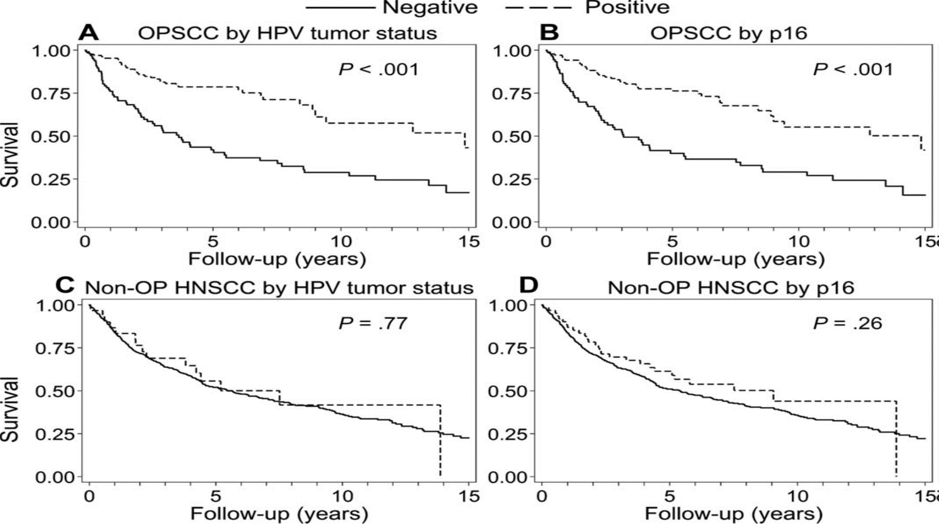
Fakhry, Westra, Wang et al. Cancer 2017 [Epub ahead of print]

Slide 19
Change 3.
Modification of T-stage for Oropharyngeal Carcinomas based on HPV status: elimination of Tis category
Carcinoma in-situ vs. invasive carcinoma
Histologic grading

Slide 20
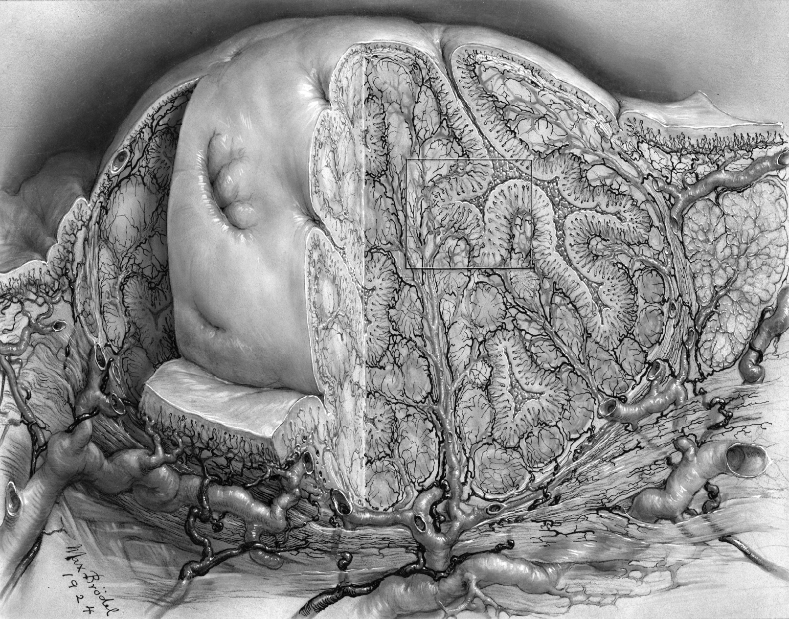
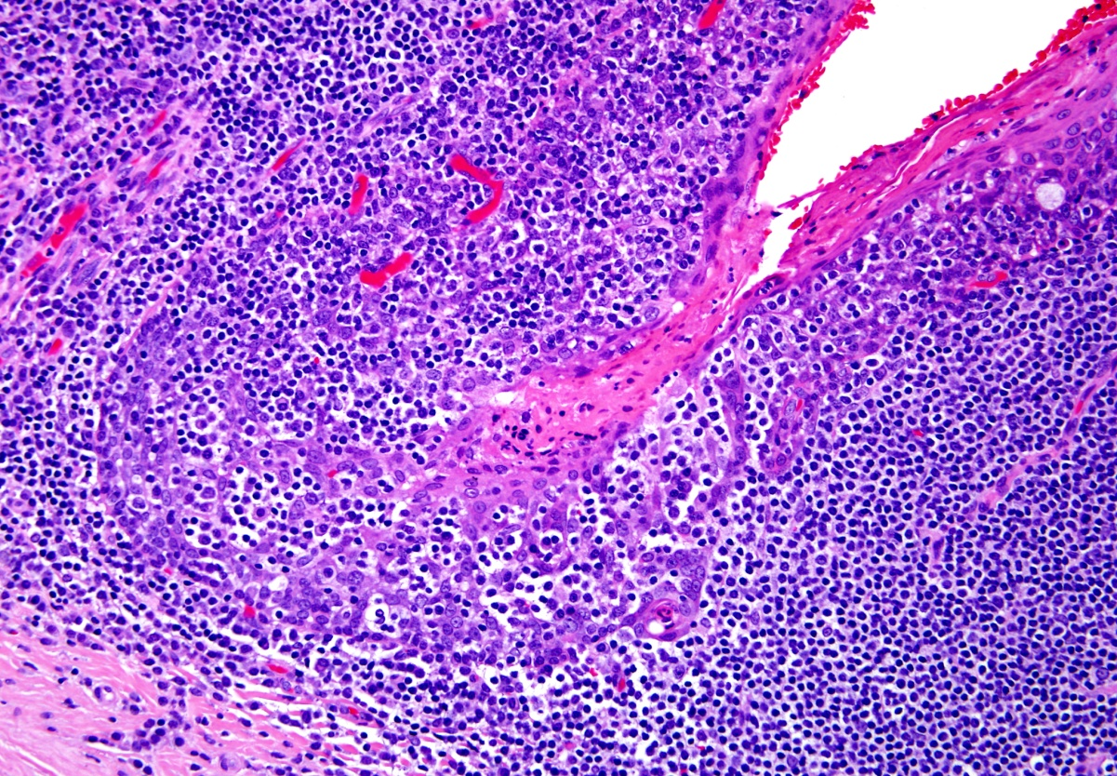
Reticulated epithelium

Slide 21
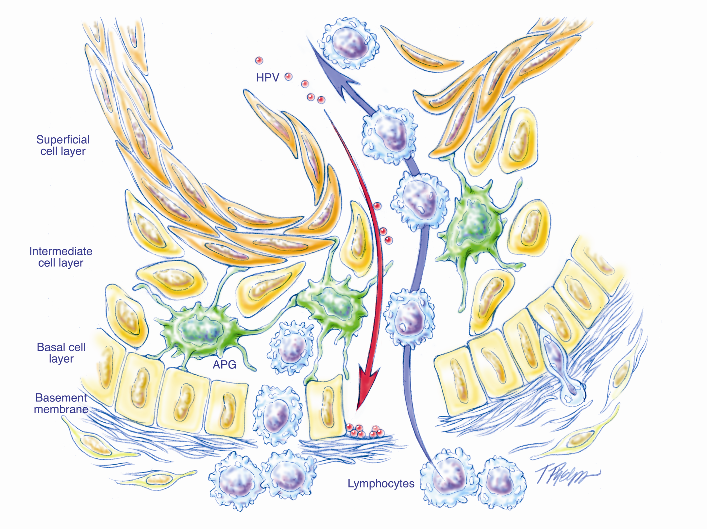
Reticulated epithelium

Slide 22
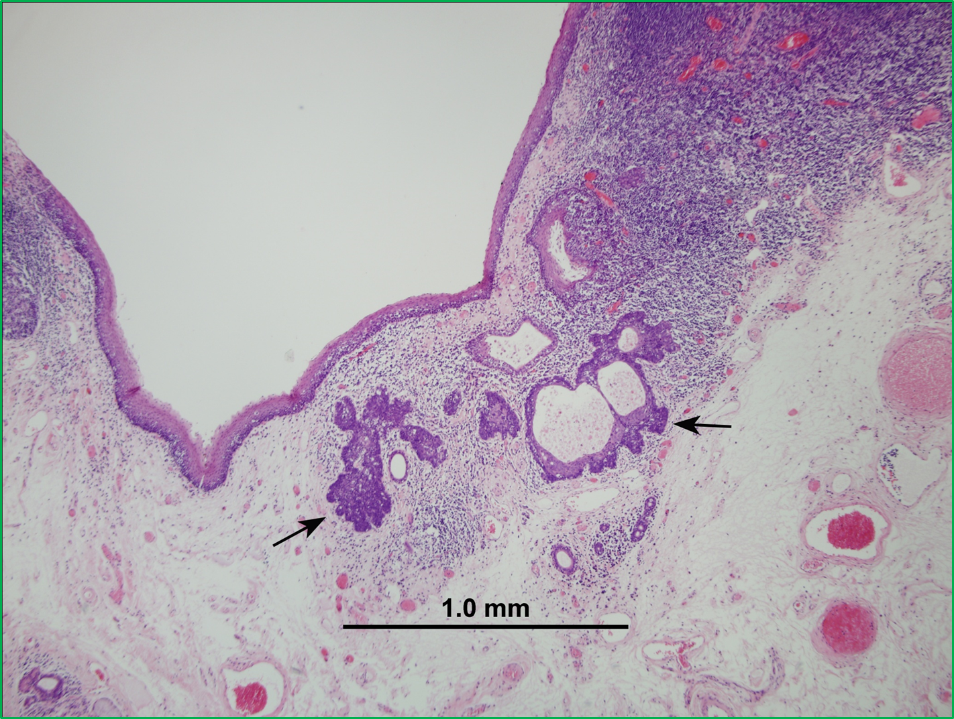
The traditional microscopic approach to the recognition of invasion is invalid for HPV-related tonsillar carcinoma
subsurface origin from tonsillar crypts
absence of stromal desmoplasia
blurred epithelial/lymphoid junction
porous nature of the B.M.
propensity for small (even occult)
carcinomas to metastasize in the
absence of clear cut stromal invasion

Slide 23
Change 3.
Modification of T-stage for Oropharyngeal Carcinomas based on HPV status: elimination of Tis category
HPV-Associated Oropharyngeal Cancer
T category | T criteria
T0 | No primary tumor identified
T1 | Tumor 2 cm or smaller
T2 | Tumor larger than 2 cm but smaller than 4 cm
T3 | Tumor larger than 4 cm or extension to lingual surface of epiglottis
T4 | Moderately advance local disease; tumor invades larynx, extrinisic muslce of tongue, medial pterygoid, hard palate, or mandible or beyond
Non-HPV-Associated Oropharyngeal Cancer
T category | T criteria
Tx | Primary tumor cannot be accessed
Tis | Carcinoma in situ
T1 | Tumor 2 cm or smaller
T2 | Tumor larger than 2 cm but smaller than 4 cm
T3 | Tumor larger than 4 cm or extension to lingual surface of epiglottis
T4a | Moderately advance local disease; tumor invades larynx, extrinisic muslce of tongue, medial pterygoid, hard palate, or mandible or beyond
T4b | Very advanced local disease; tumor invades lateral pteryoid muscle, pterygoid plates, lateral nasopharynx, or skull base or encases carotid artery

Slide 24
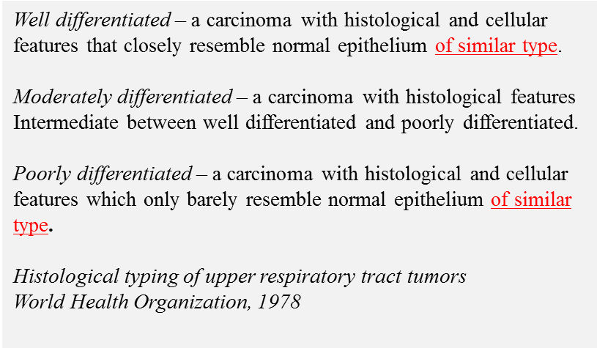
Change 4.
Eliminate tumor grading of HPV-positive oropharyngeal squamous cell carcinoma
Carcinoma in-situ vs. invasive carcinoma
Histologic grading

Slide 25
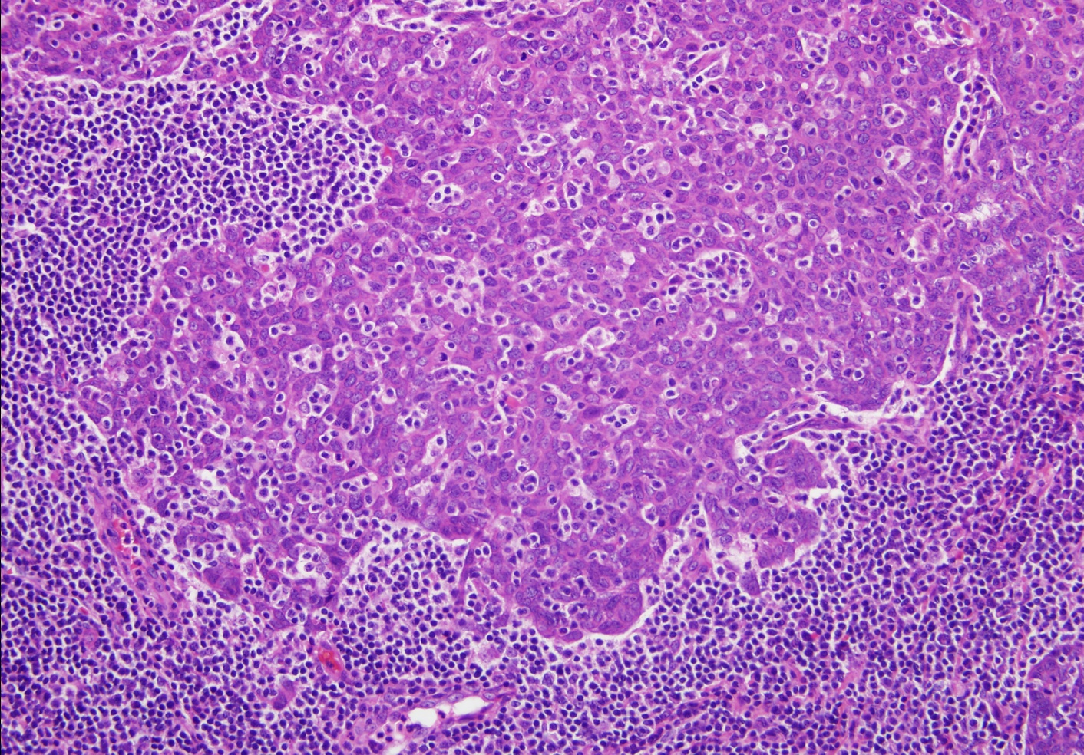
Histologic grading of
HPV-related HNSCC

Slide 26
*
*

Slide 27
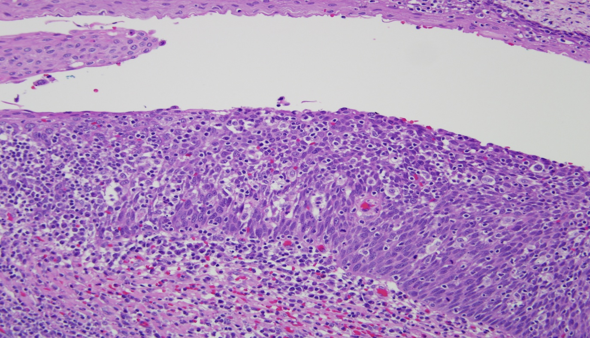
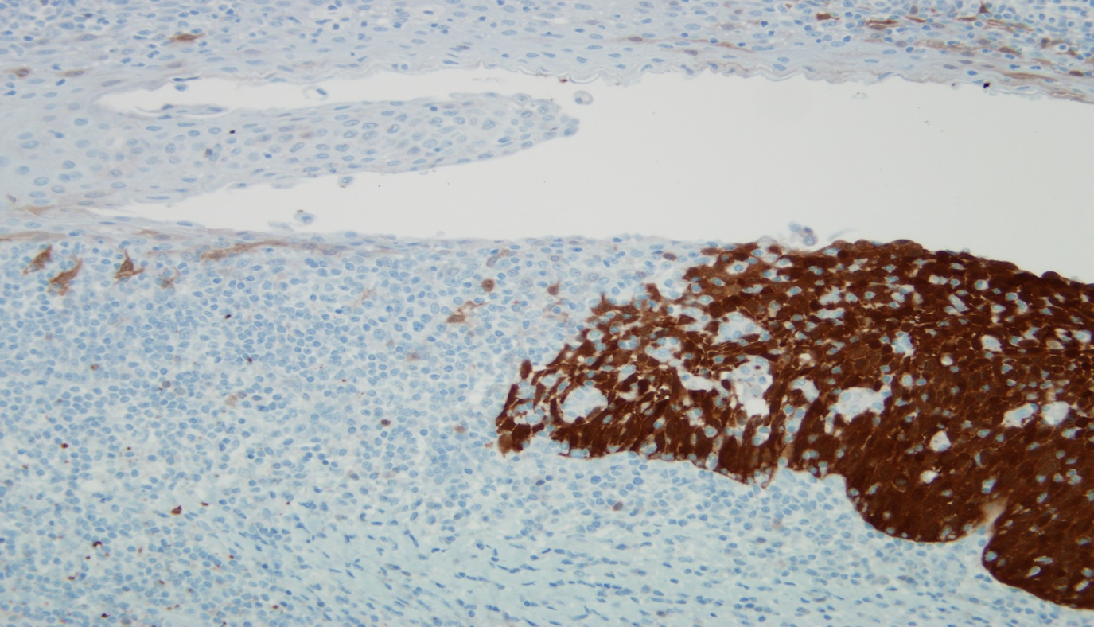
Change 4.
Eliminate tumor grading of HPV-positive oropharyngeal squamous cell carcinoma (AJCC, W.H.O., C.A.P.)

Slide 28
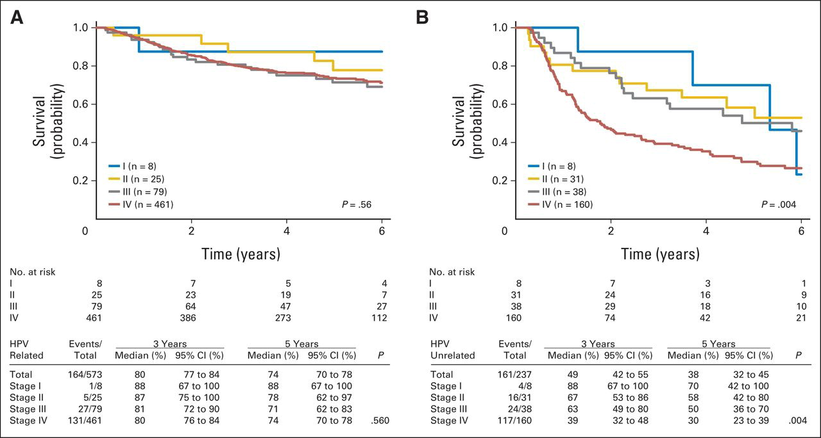
Change 5.
Refinement of nodal staging for more effect stratification of survival outcomes as a function of HPV status
Fig 1. Overall survival by current American Joint Committee on Cancer/Union for International Cancer Control TNM stage in (A) human papillomavirus (HPV) –related and (B) HPV-unrelated oropharyngeal carcinomas.
Shao Hui Huang; Wei Xu; John Waldron; Lillian Siu; Xiaowei Shen; Li Tong; Jolie Ringash; Andrew Bayley; John Kim; Andrew Hope; John Cho; Meredith Giuliani; Aaron Hansen; Jonathan Irish; Ralph Gilbert; Patrick Gullane; Bayardo Perez-Ordonez; Ilan Weinreb; Fei-Fei Liu; Brian O'Sullivan; JCO 2015, 33, 836-845.
DOI: 10.1200/JCO.2014.58.6412
Copyright © 2015 American Society of Clinical Oncology

Slide 29
Change 5.
Refinement of nodal staging for more effect stratification of survival outcomes as a function of HPV status
Pathologic N category for HPV-negative oropharyngeal cancer
N category | N criteria
Nx | Regional lymph nodes cannot be addressed
N0 | No regional lymph node metastasis
N1 | Single ipsilateral lymph nodes, 3 cm or less, and ECE negative
N2a | Single ipsilateral or contralateral node 3 cm or less and ECE (+); or single ipsilateral node > 3 and < 6 cm and ECE (-)
N2b | Multiple ipsilateral lymph nodes, none larger than 6 cm and ECE (-)
N2c | Bilateral lymph nodes, none larger than 6 cm and ECE (-)
N3a | Lymph node > 6 cm and ECE (-)
N3b | Single ipsilateral node > 3 cm and ENE (+); or multiple ipsilateral, contralateral or lilateral nodes, any with ENE (+)
* Pathologic N category for HPV-positive oropharyngeal cancer
N category | N criteria
NX | Regional lymph nodes cannot be accessed
N0 | No regional metastases
pN1 | Metastasis in 4 or fewer lymph nodes
pN2 | Metastasis in more than 4 lymph nodes
*nodal staging is not impacted by size,
location or extranodal extension (ENE)!

Slide 30
What is extranodal extension (ENA)?
Extension of metastatic carcinoma through the fibrous
node capsule and into perinodal soft tissues
Minor ENE: ≤ 2 mm beyond node capsule
Major ENE: ˃ 2 mm beyond node capsule
Major ENE includes soft tissue implants
Major and minor subcategories are for data collection
purposes only (both ENE positive for staging purposes)

Slide 31
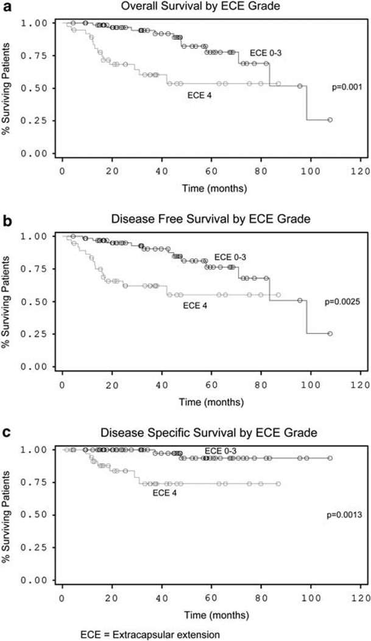
Why is extracapsular extension not a staging parameter for HPV-associated oropharyngeal cancer?
1. Not predictive
2. Not reproducible
Lewis et al. Mod Pathol 24:1413, 2011

Slide 32
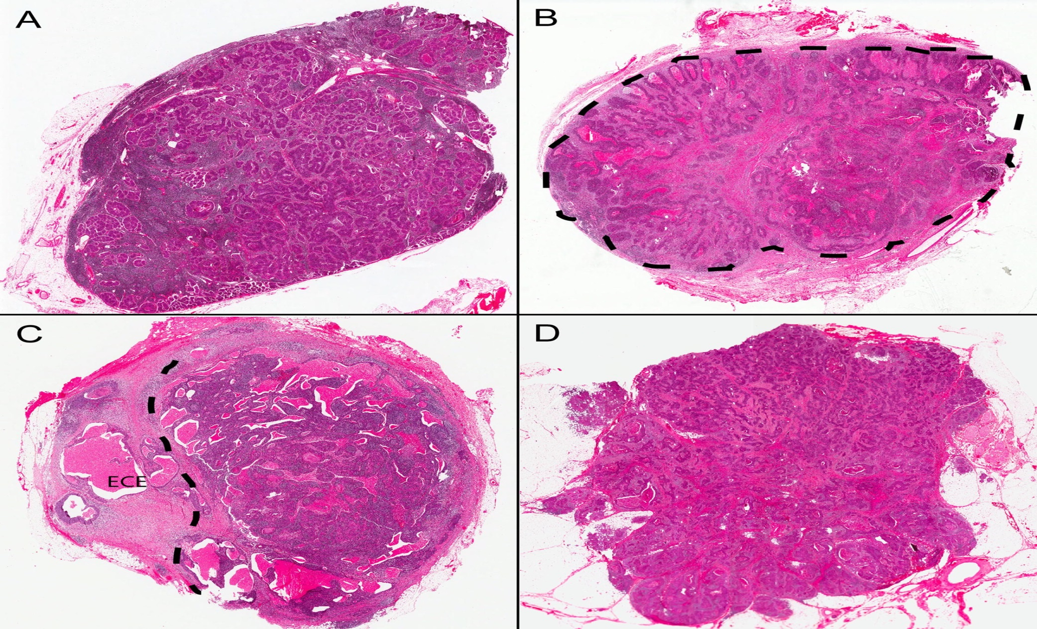
Why is extracapsular extension not a staging parameter for HPV-associated oropharyngeal cancer? Not reproducible
Inter- and intra-observer variability in the classification of extracapsular extension in p16 positive oropharyngeal squamous cell carcinoma nodal metastases.

Slide 33
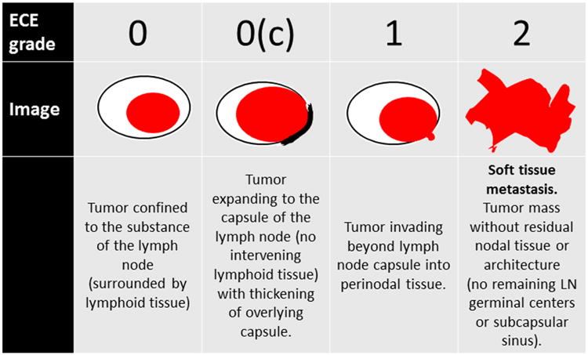
Using individual criteria, all 5 agreed in 48% of cases
Using standardized criteria, all 5 agreed in 68% of cases
Lewis et al. Oral Oncol
51:985,2015

Slide 34
The dirty little secret
of Head & Neck Tumor Boards

Slide 35
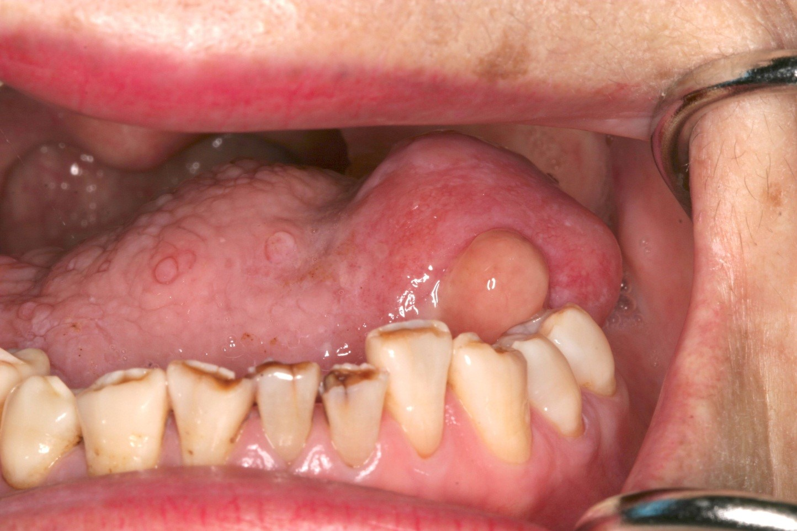
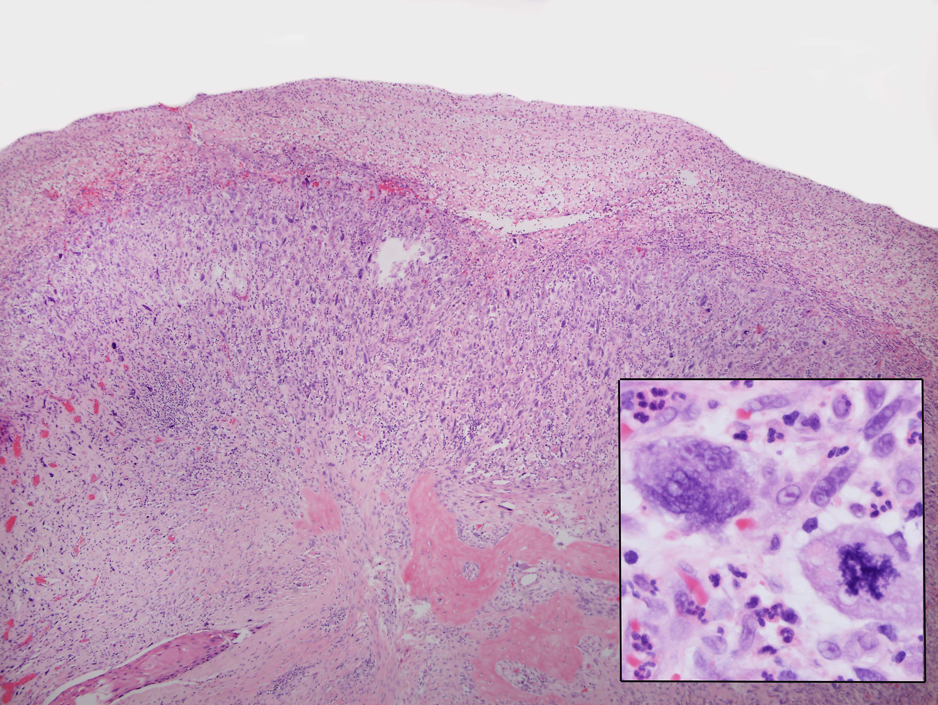

Slide 36
Change 6.
For oral cavity squamous cell carcinoma, T stage now incorporates depth of invasion (DOI)
For every 5 mm increase in DOI, pT category increasing by one level (≤ 5mm, ˃ 5mm but ≤ 10 mm, ˃ 10 mm).
DOI supersedes tumor thickness as a staging parameter

Slide 37
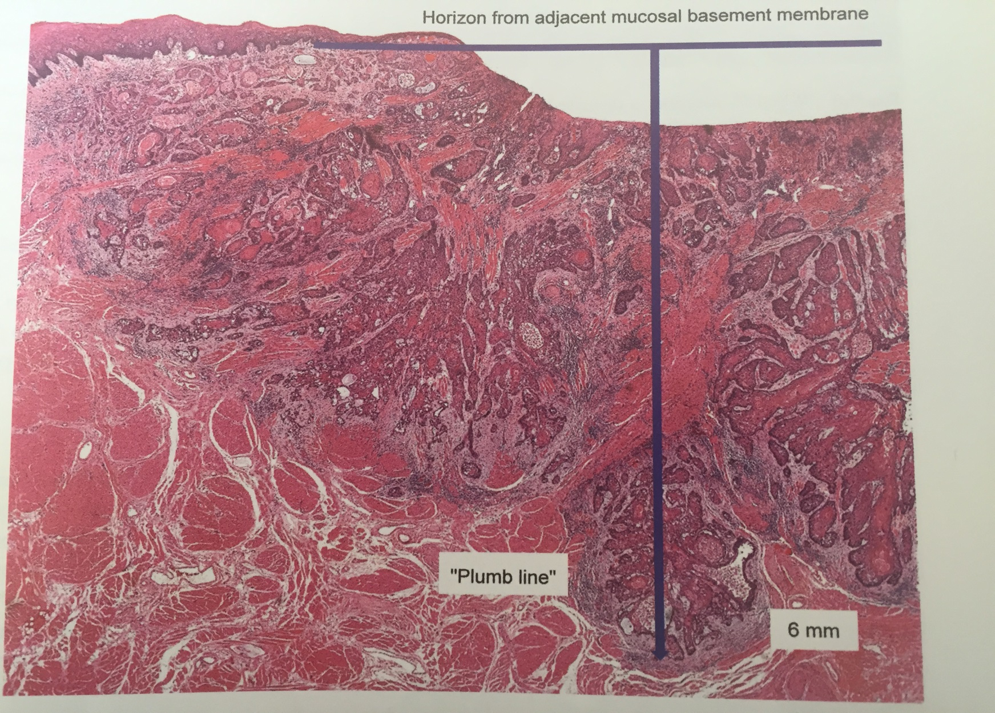
Transverse dimension
Tumor thickness
Depth of invasion

Slide 38
