Slide 1
Case 4
A 48 year old female presented with an ill-defined mass on a screening mammogram.
A diagnosis of invasive carcinoma was made on a core needle biopsy.
The images are from the subsequent nipple-sparing mastectomy.

Slide 2
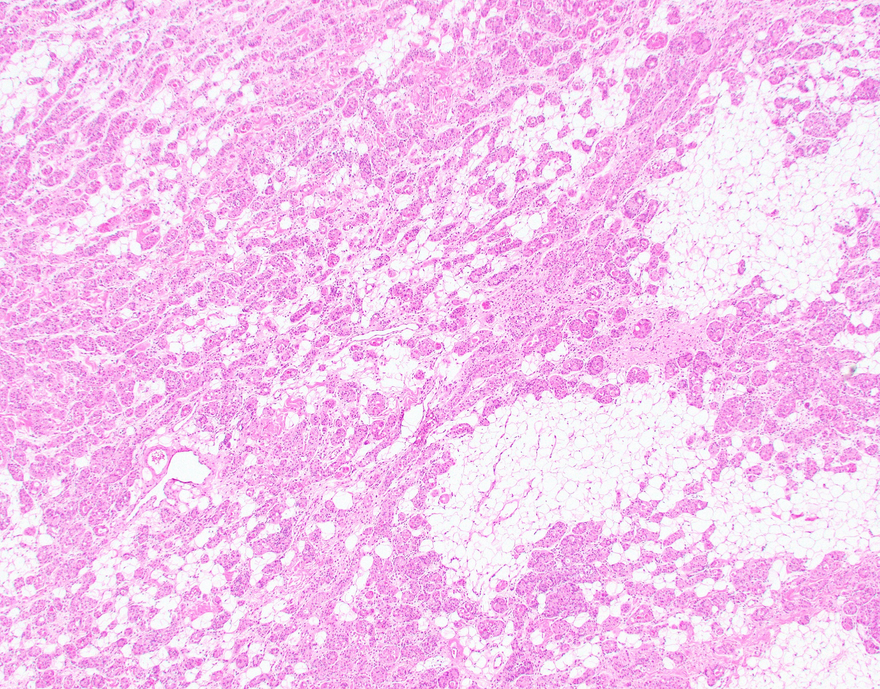

Slide 3
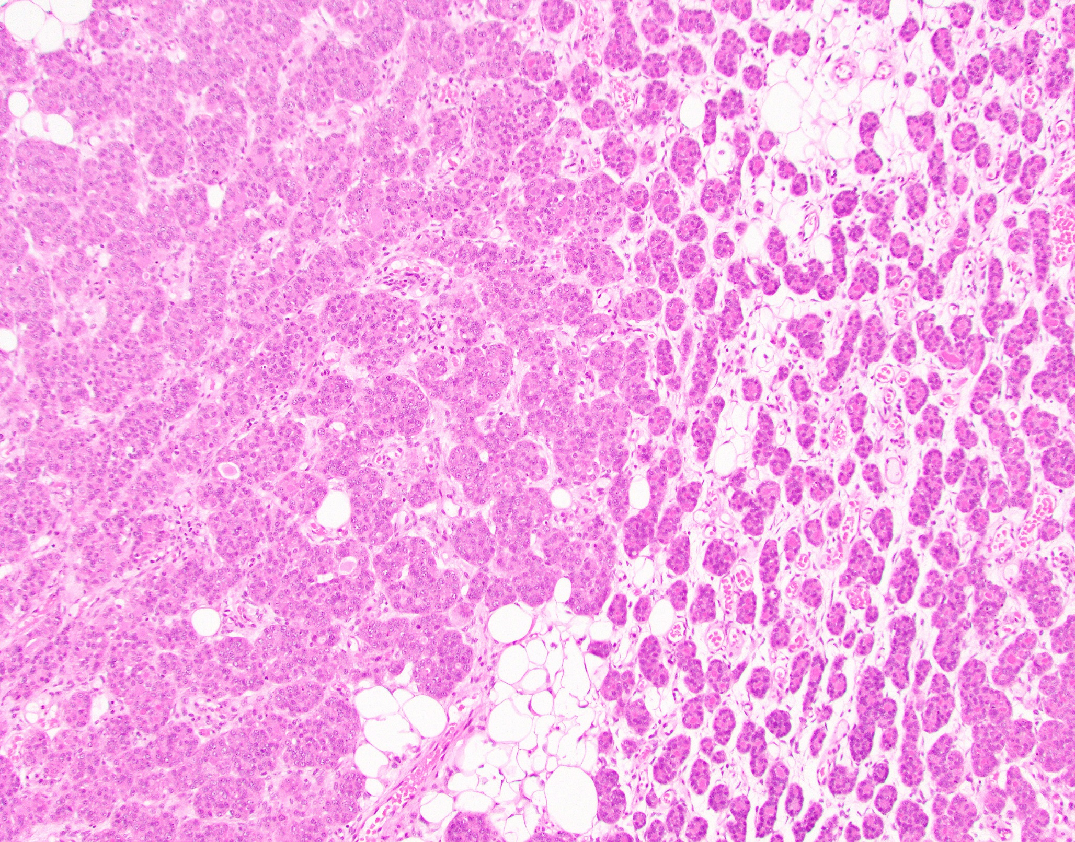

Slide 4
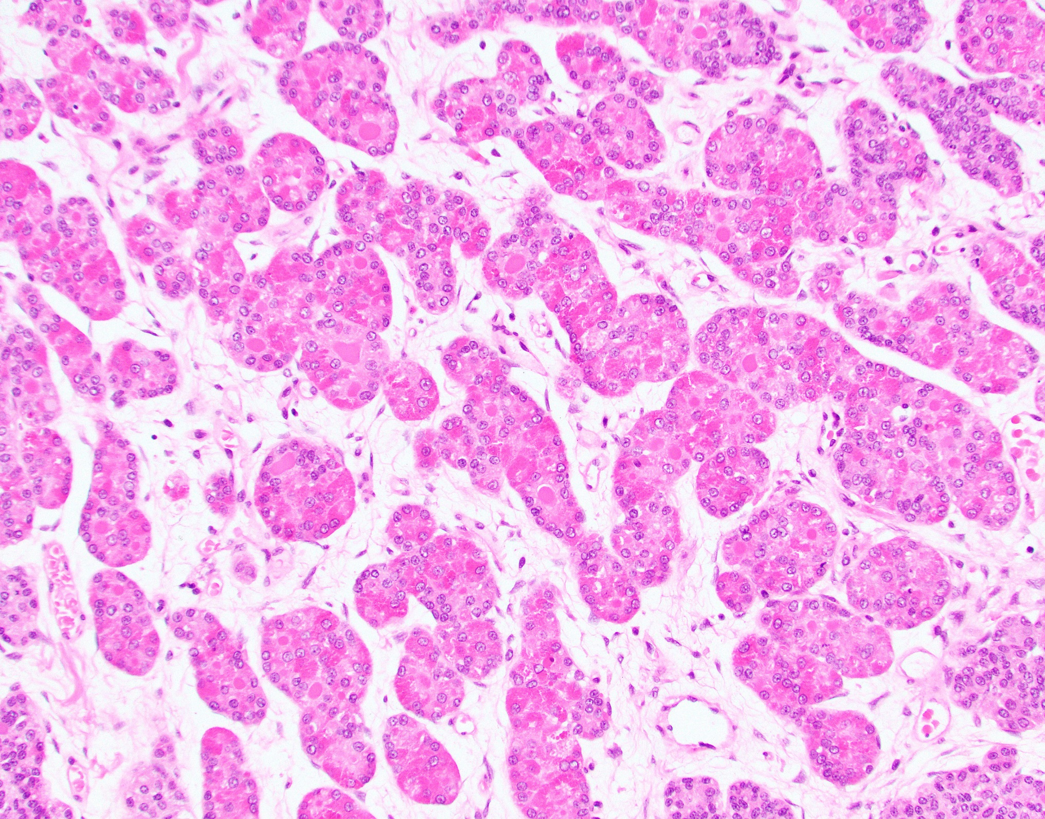

Slide 5
