Slide 1
Case 3
A 58 year old female presented with an ill-defined mass on a screening mammogram.
A core needle biopsy showed “mucinous carcinoma”.
The images are from the subsequent surgical excision.

Slide 3
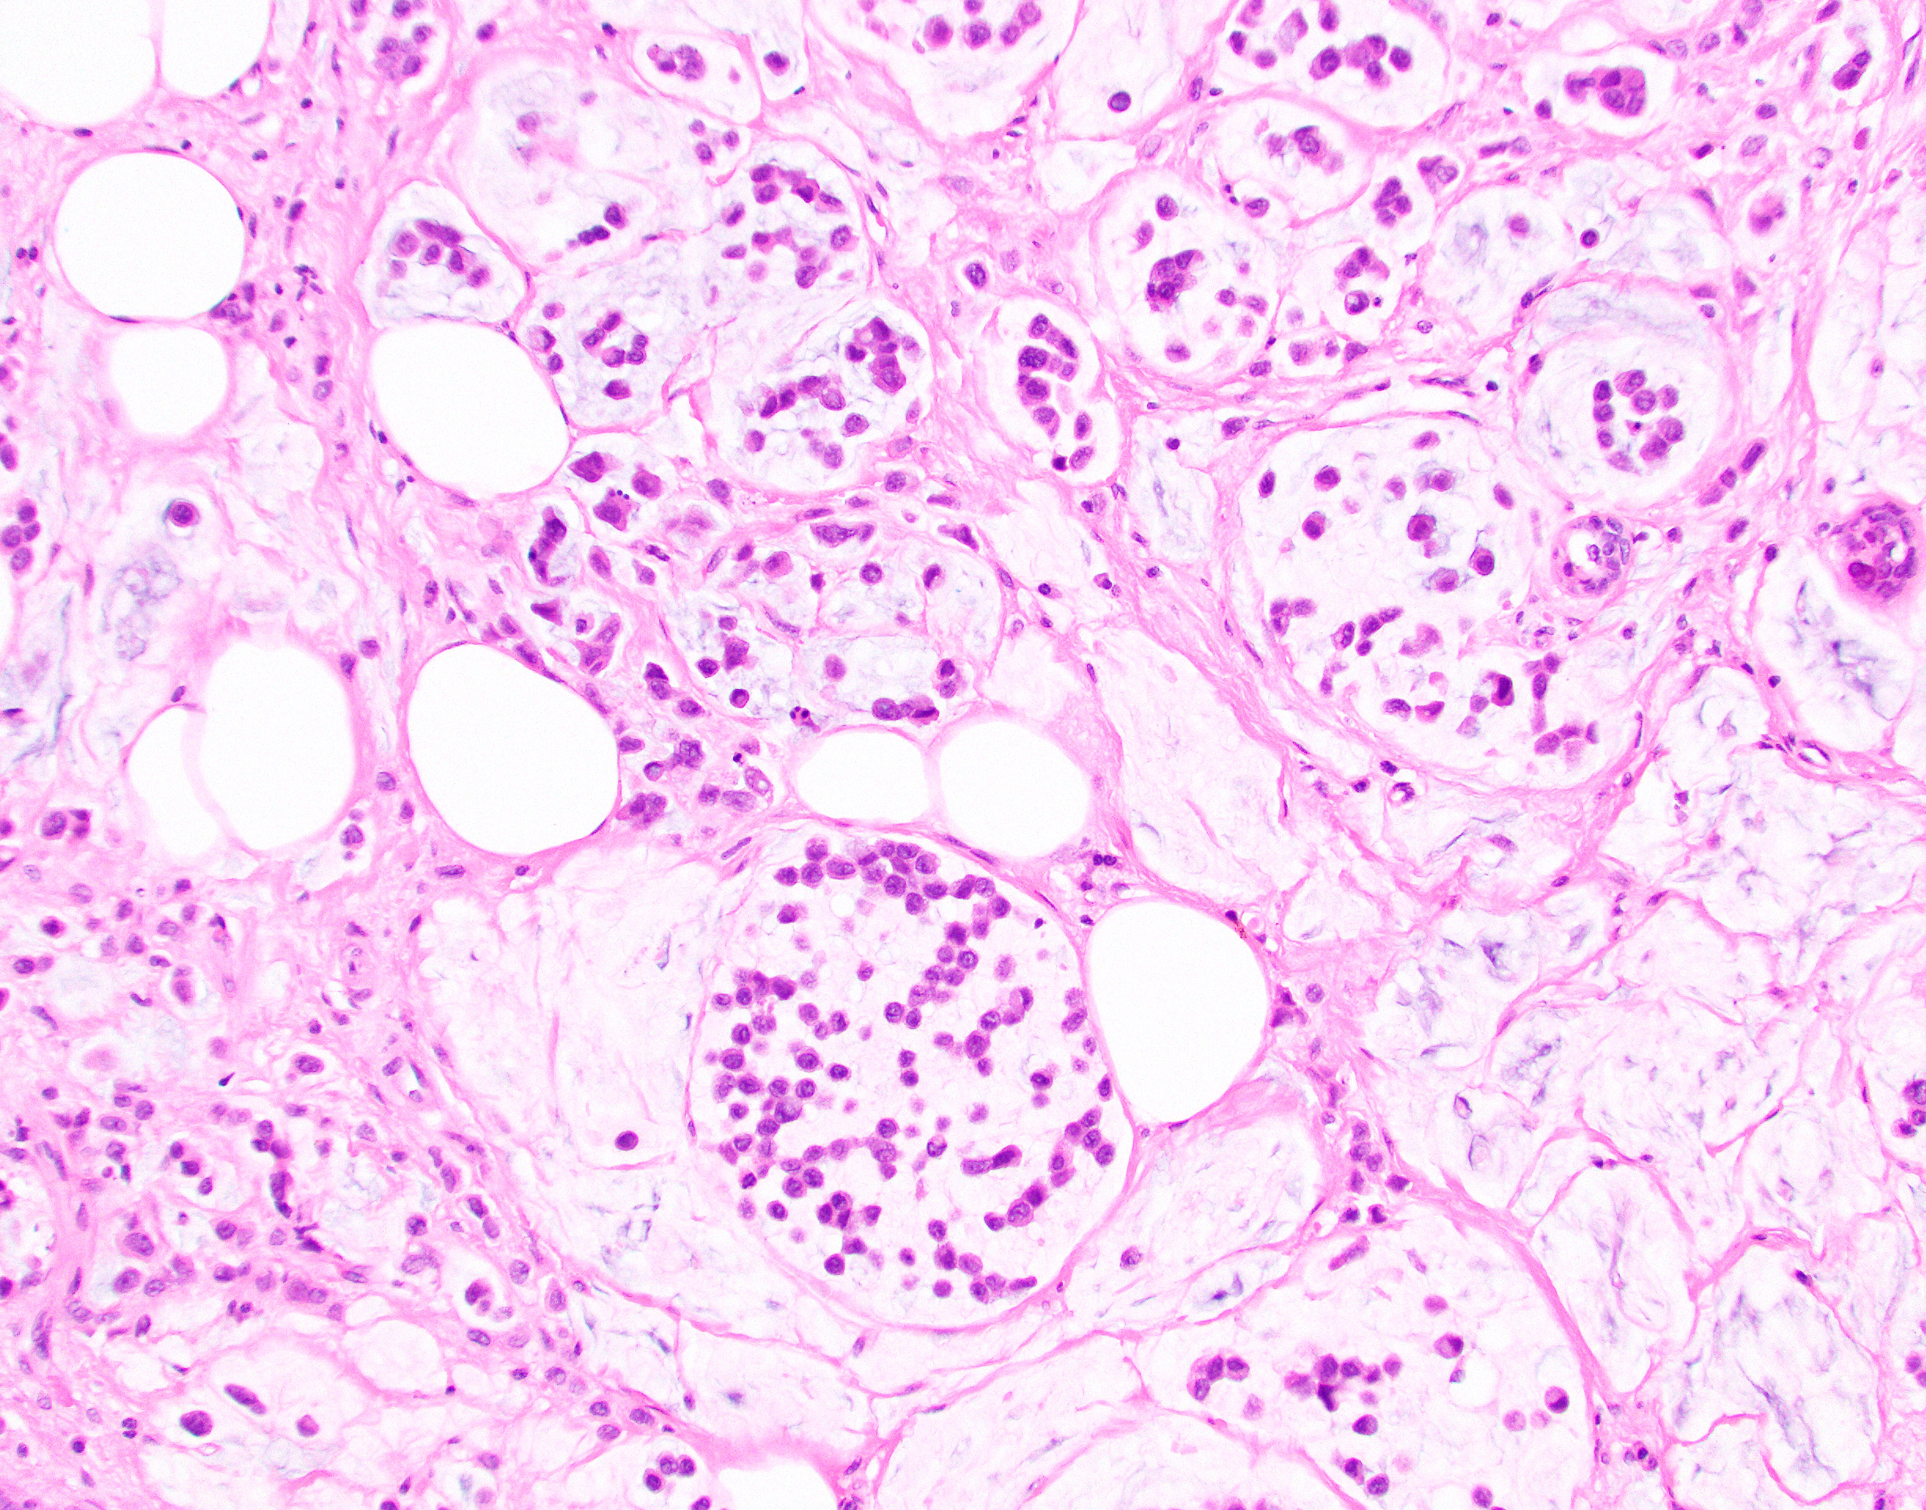

Slide 4
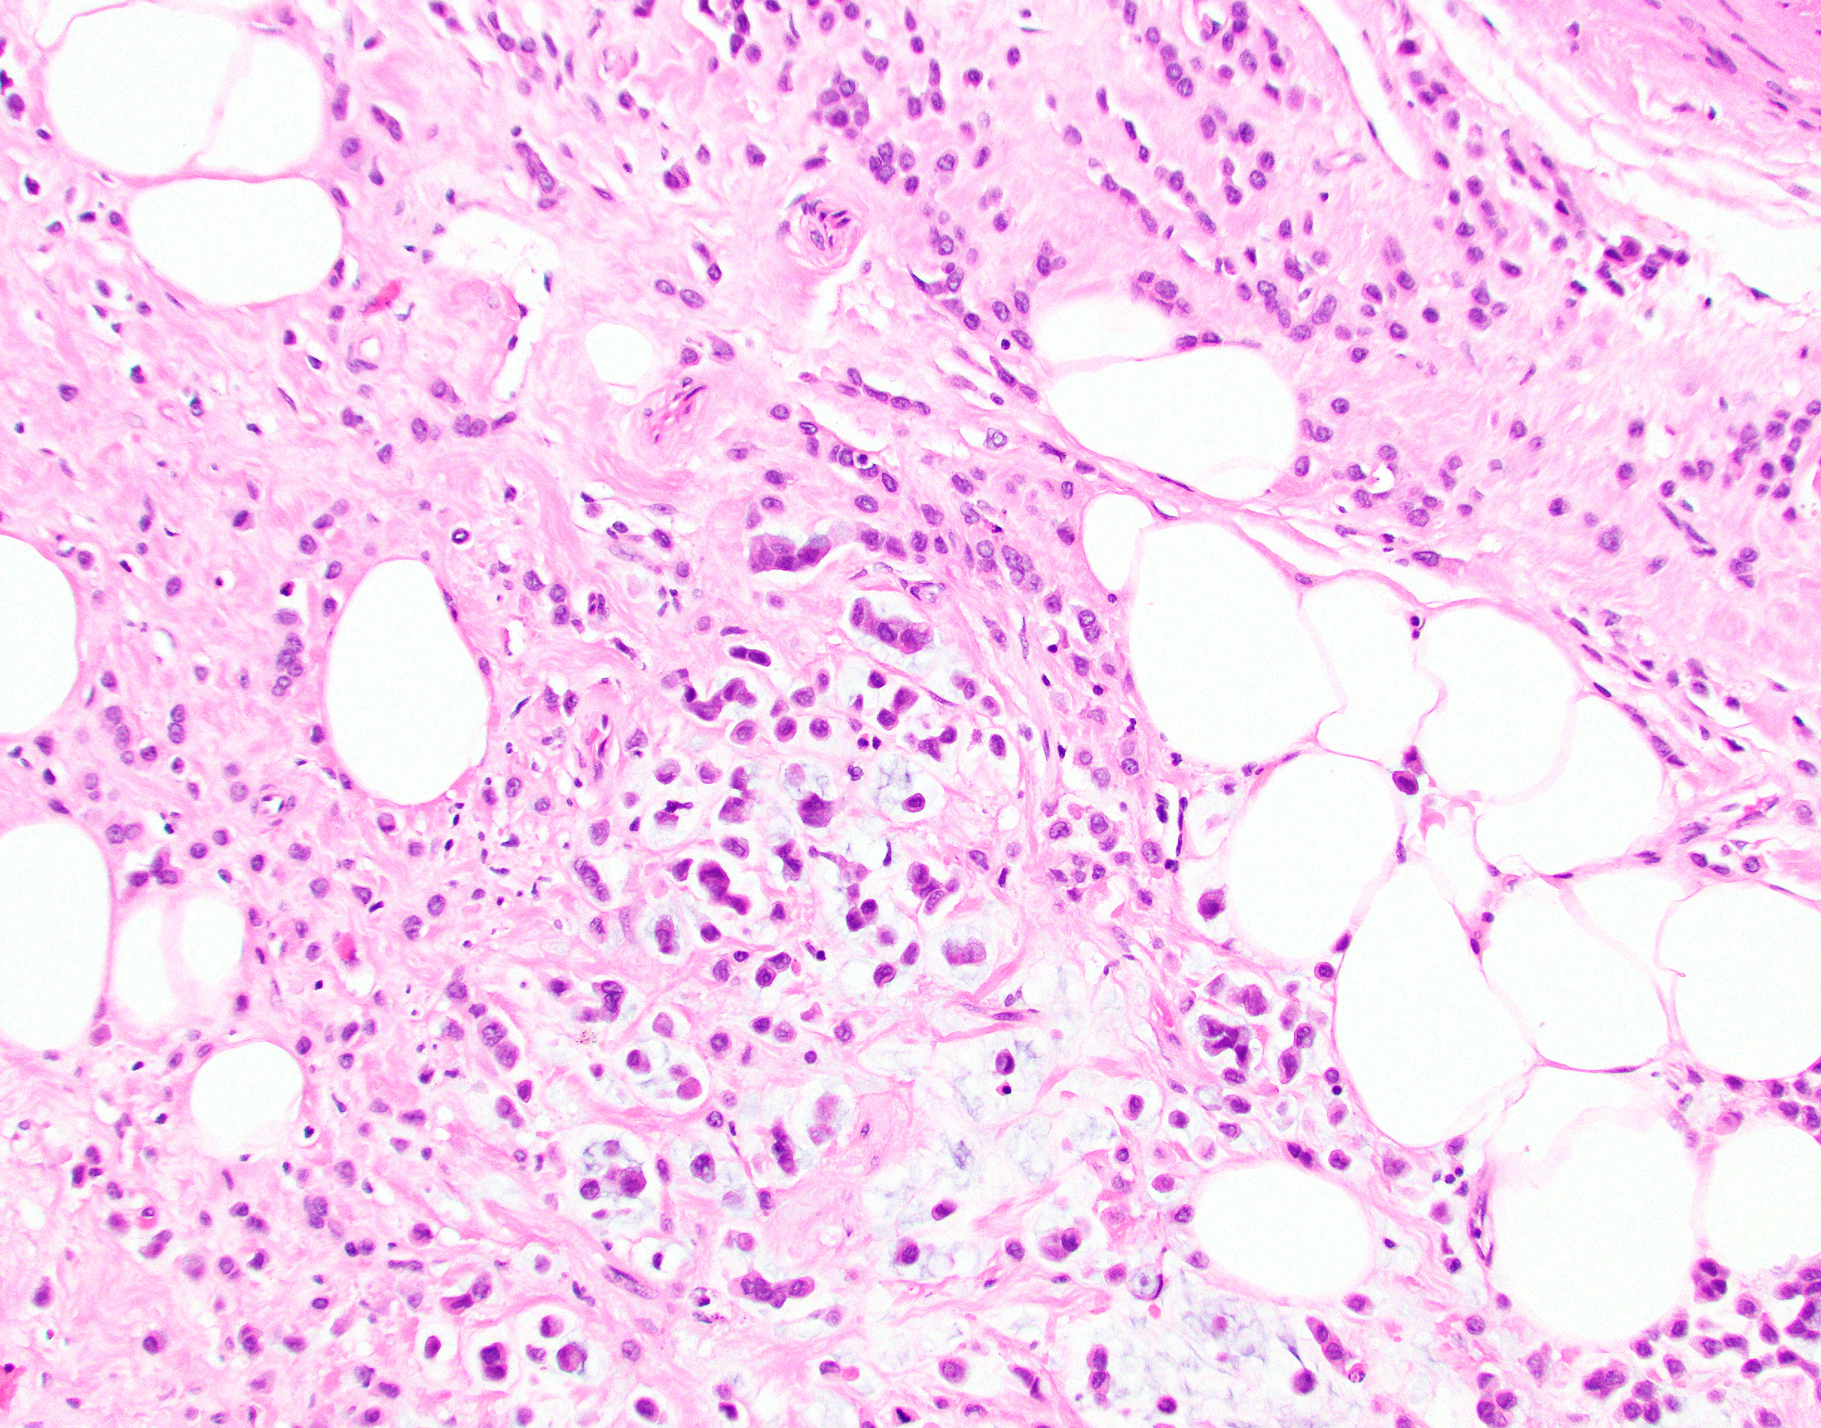

Slide 5
