Slide 1
Case 1
A 68 year old female was found to have left breast mass in the 2:00 position on a screening mammogram.
An ultrasound-guided core needle biopsy was performed.

Slide 2
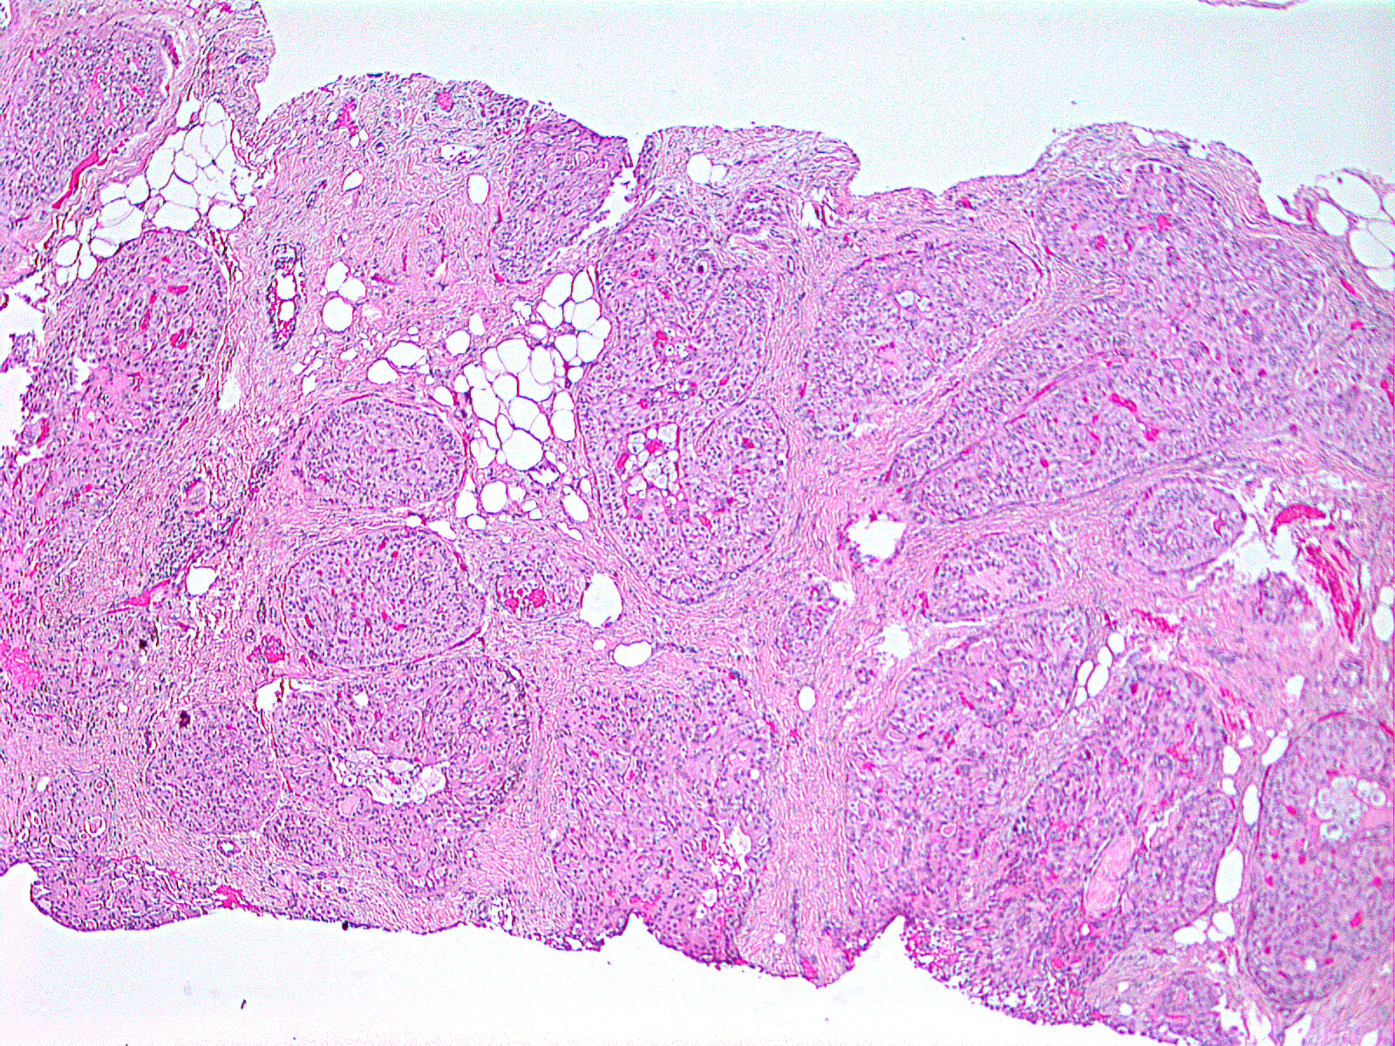

Slide 3
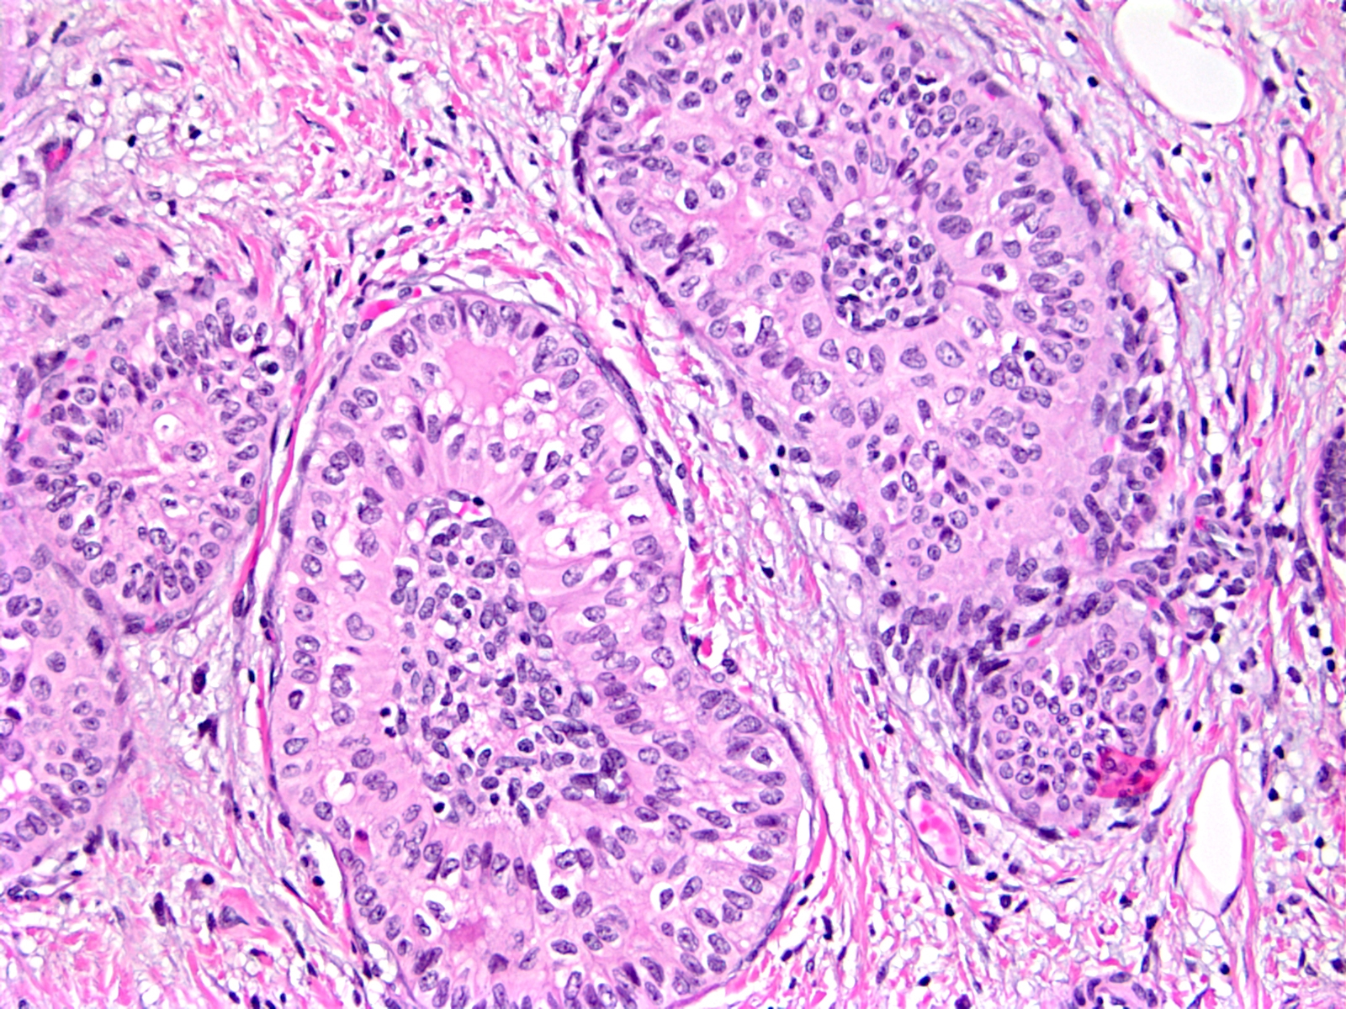

Slide 4
